Slide 1

CODEP: Grammatical Seq2Seq Model for
General-Purpose Code Generation
Yihong Dong¹, Ge Li^{1*}, Zhi Jin^{1*}
¹Peking University, China
*Corresponding author
AKA (CodePAD: Sequence-based Code Generation with Pushdown Automaton)

Slide 2
PART 01
Introduction

Slide 3
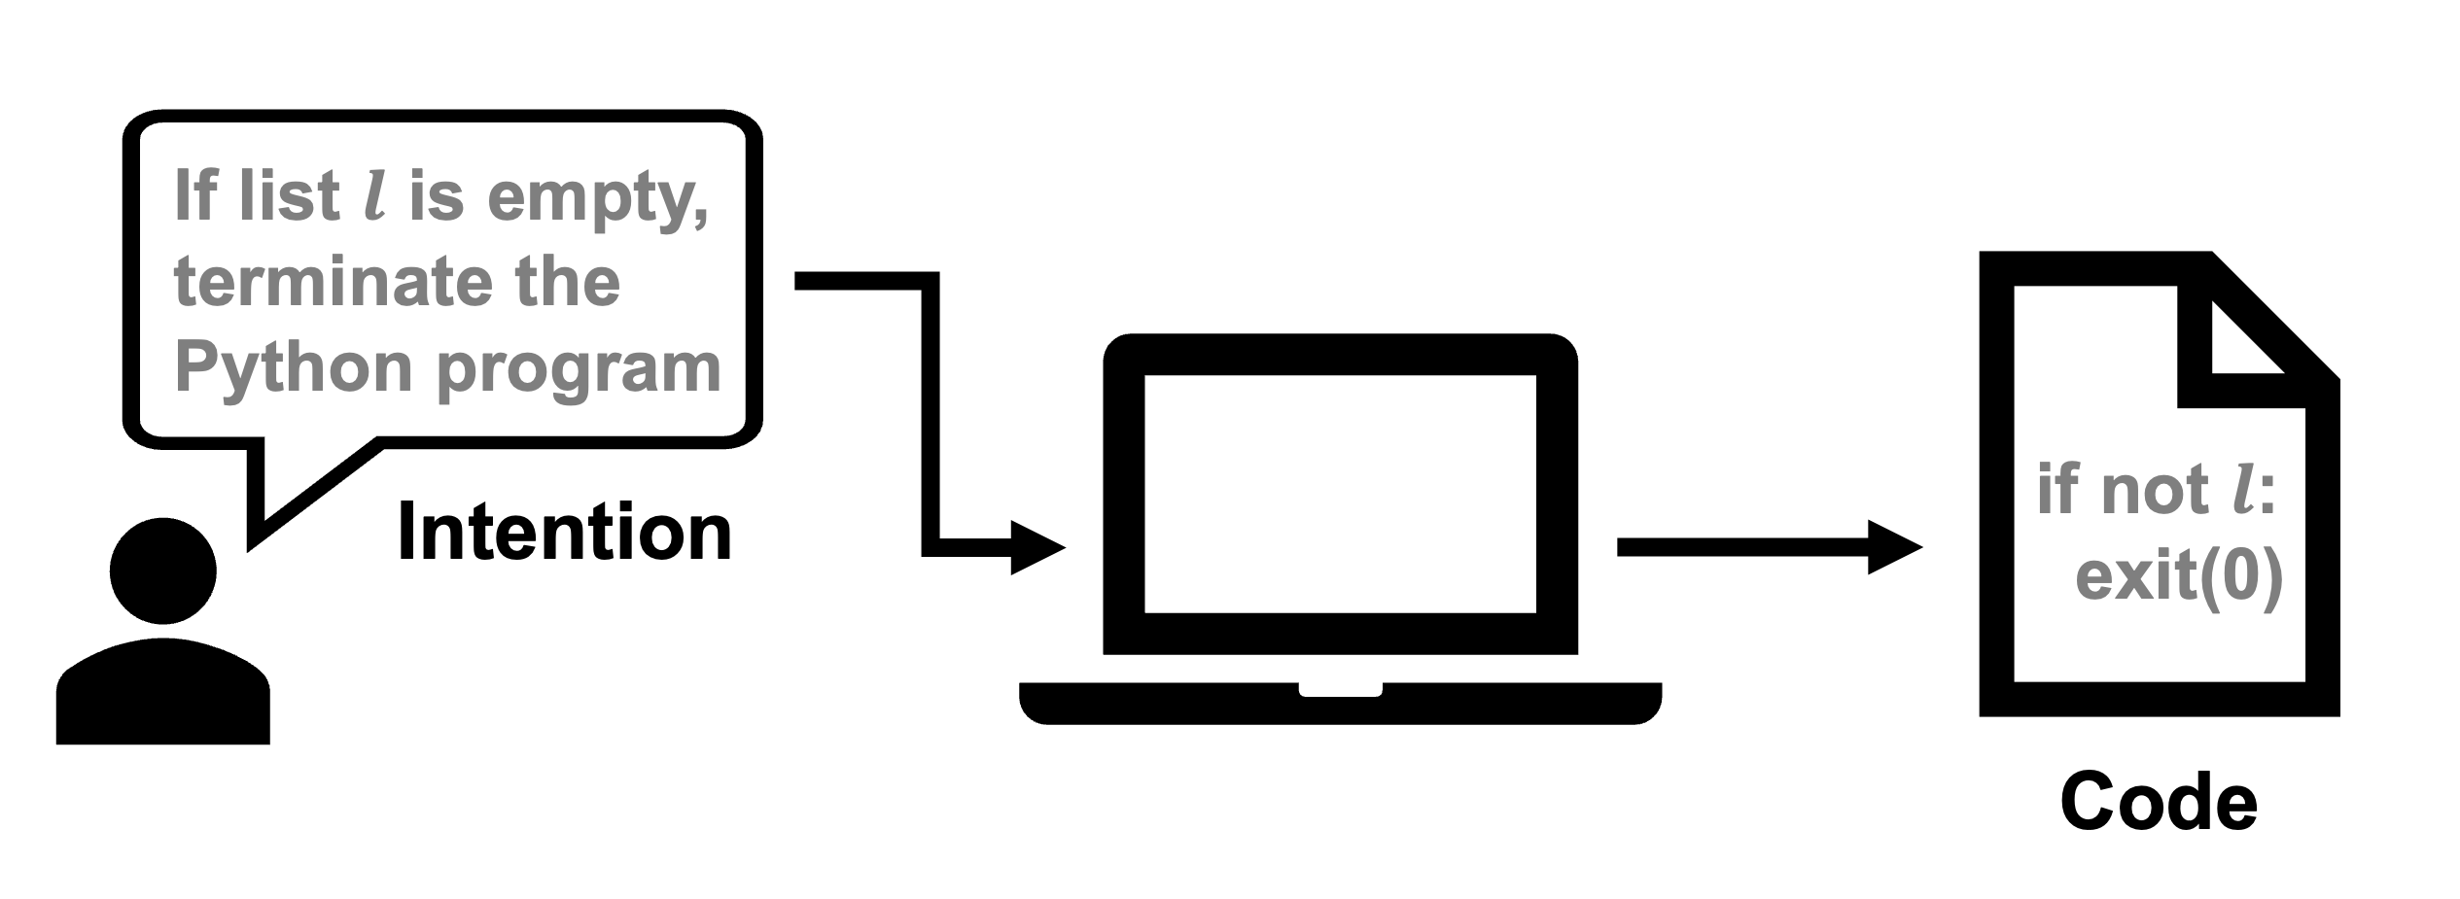
Introduction - Code Generation
Code Generation
Natural language (NL) description to code
Domain-specific programming language (PL) like SQL.
General-Purpose PL like Python.
Facilitate software development and revolutionize user programming.

Slide 4
Introduction
A well-designed code generation approach requires consideration of grammar in addition to semantics
Semantics ensures the functionality of code meets developer's intention.
Satisfying grammar is a basic requirement for programming.
Therefore, in the process of code generation, it is essential to guarantee the generated code satisfies grammar constraints of PL.

Slide 5
Introduction - Seq2Seq approaches
The most commonly used code generation approaches.
High efficiency.
Convenient operation.
Easy data accessibility.
However, most Seq2Seq approaches generate codes with no guarantee of grammatical correctness (GC).
Hinder the usability of generated codes.

Slide 6
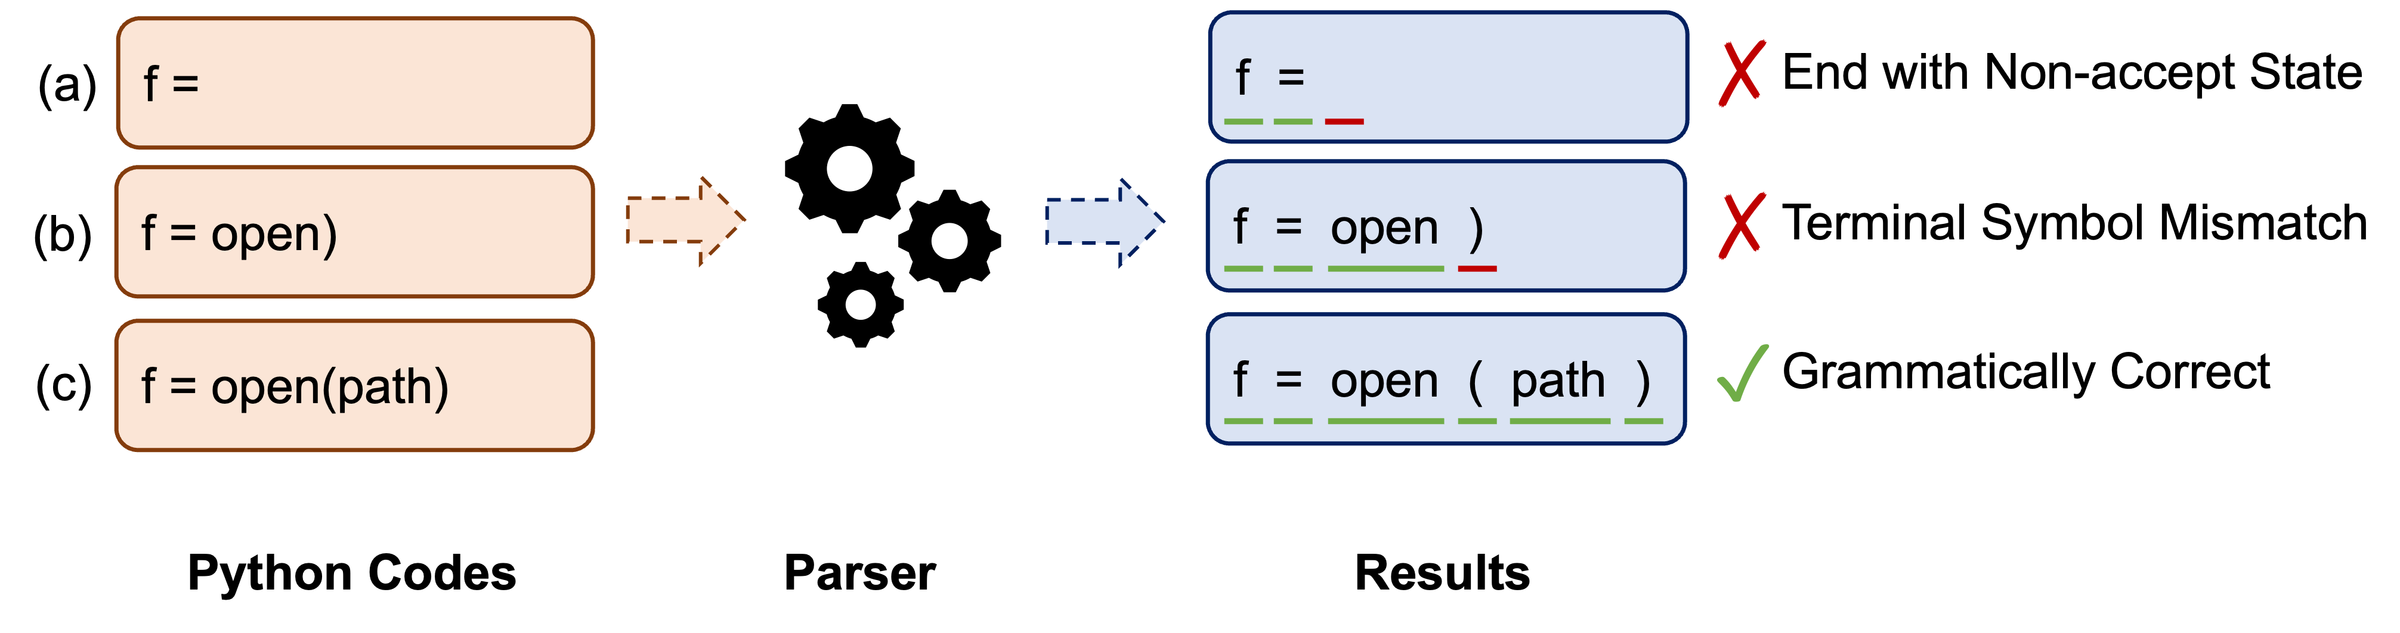
Introduction - Pushdown Automaton (PDA)
There are two typical grammatical error to consider in a practical code generation process:
End with non-accept state (ENS) error.
Terminal symbol mismatch (TSM) error.
PDA
Suitable for PL grammar.
Can deal with non-grammatical problems of Seq2Seq-based code generation.
ENS error : an accept state set for recognizing completed code.
TSM error : a valid terminal symbol set for next token prediction.
As a result, constraining Seq2Seq-based code generation based on PDA to guarantee GC is a matter of course.

Slide 7
Introduction
It is inspired by the operating principle of PL parsers in practice.
Nonetheless, applying a parser to constrain Seq2Seq-based code generation suffers from the following two problems.

Slide 8
Introduction
The vast majority of codes generated during this situation are incomplete.
Parsing these codes will produce ENS errors like case (a).
A parser can only recognize TSM errors like case (b) if terminal symbol is fed to the parser.
Seq2Seq Models need to attempt each generated token in the candidate set one by one, which is strenuous.
In short, although code can be grammatically bounded by a parser, it is still challenging to work with the parser directly.

Slide 9
Introduction
In this paper, we devise a PDA-based methodology to make the first attempt to consider grammatical Seq2Seq models for general-purpose code generation
Exploiting the principle that PL is a subset of PDA recognizable language and code accepted by PDA is grammatical.
Guided by this methodology, we further propose CODEP, a code generation framework equipped with a PDA module, to integrate the deduction of PDA into deep learning.

Slide 10
PART 02
Motivation Example

Slide 11
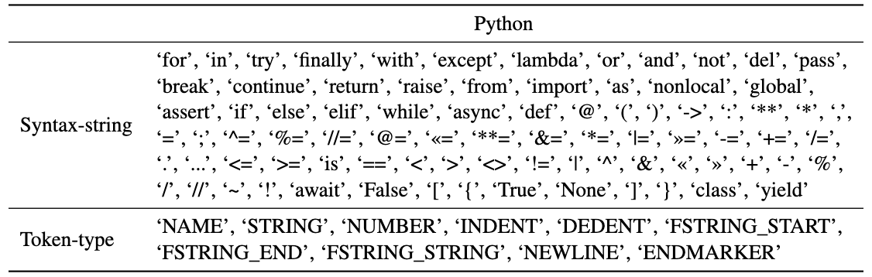
Motivation Example
Given an NL, CODEP needs to generate code that satisfies its intended functionality with the guarantee of GC.
PDA module gives a valid set of terminal symbols (i.e., candidate syntax-strings and token-types) depending on grammar constraints, to which the generated token of CODEP should belong.

Slide 12
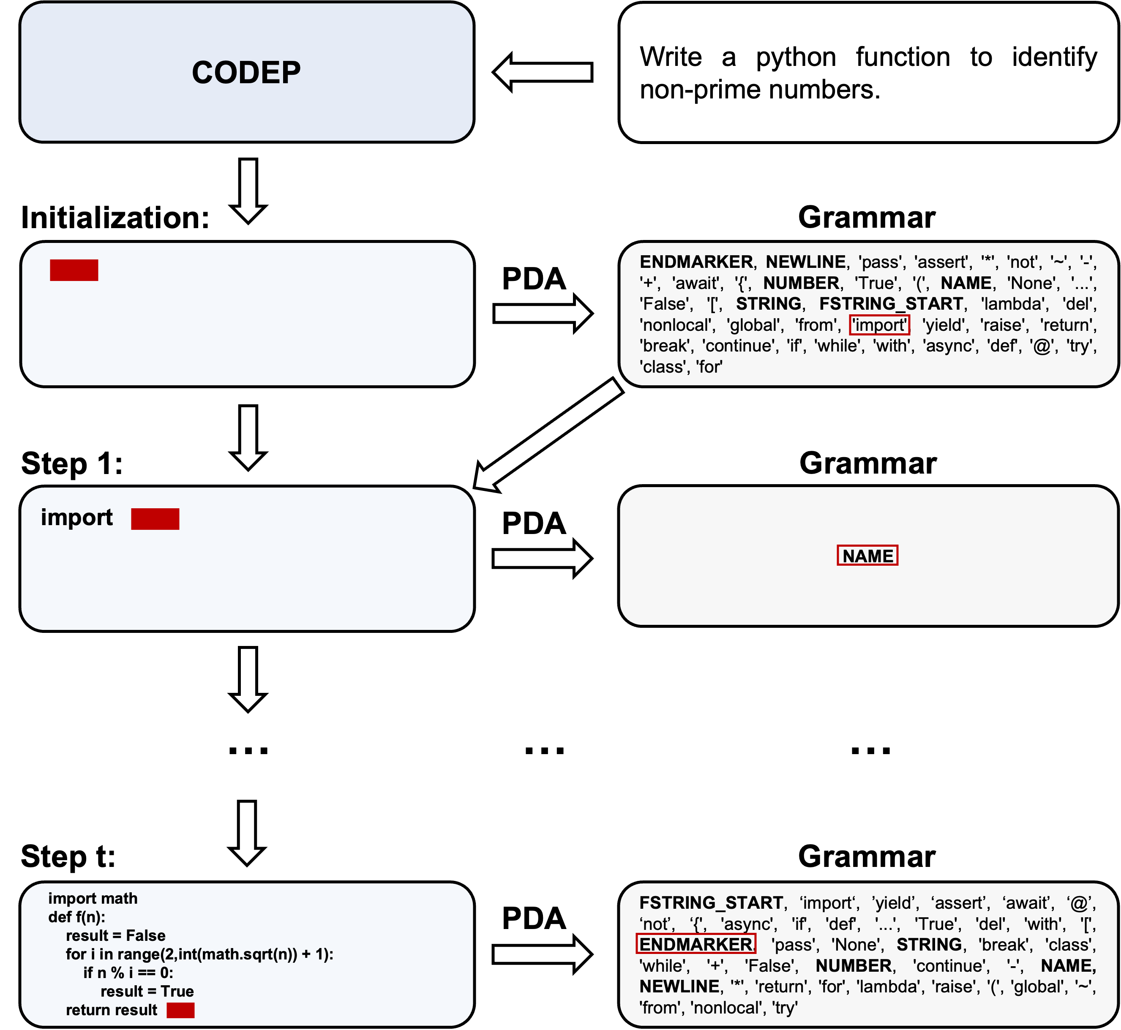
Motivation Example
In the beginning, based on production rules, PDA module shrinks the candidate set from entire vocabulary to 35 syntax-strings and 6 token-types.
Each candidate token is constrained by grammar.
At step 1, CODEP picks a token (i.e., ‘import’) from the candidate set according to semantics.

Slide 13
Motivation Example
At each subsequent generation step, CODEP predicts a token in the same manner, which satisfies grammar constraints.
Until the end of generation steps, CODEP outputs the token of ENDMARKER token-type (e.g., </s>), which ends with an accept state.
Thus, CODEP generates a grammatical code with the help of PDA module.

Slide 14
PART 03
Related
Work

Slide 15
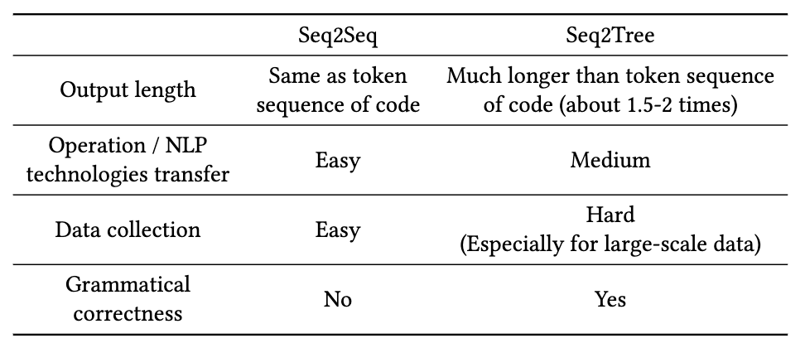
Related Work
Seq2Seq Model
Seq2Seq^{[1]}
Pre-trained models, such as CodeT5^{[2]}, UniXcoder^{[3]}, Codegen^{[4]} and InCoder^{[5]}.
Although Seq2Seq-based approaches are most commonly used for code generation, they usually cannot guarantee GC.
Seq2Tree Model
Seq-to-Tree^{[6]}
TranX^{[7]} and its improvements ML-TranX^{[8]}, TranX-RL^{[9]}, APT ^{[10]} and Subtoken-TranX ^{[11]}.
Compared to Seq2Tree approaches, our proposed method not only ensures GC but also avoids the disadvantages of Seq2Tree approaches.

Slide 16
Related Work
Grammatical Seq2Seq Model for Domain-specific Code Generation
PICARD^{[12]}
The cost of attempts could be overwhelming for large vocabulary, and general-purpose PLs (GPLs) usually have a much larger vocabulary than domain-specific PLs (DSLs).
CSD^{[13]}
Use a intuitive method to deal with easy grammar of DSLs, but GPLs usually have more complicated grammar than DSLs.
As mentioned at the end of their paper, CSD cannot handle GPLs like Python.
Both of them cannot extend to GPLs like Python. For all we know, the grammatical Seq2Seq model for general-purpose code generation has not yet been studied.
There is a great need to ensure GC of Seq2Seq approaches for all PLs (including DSLs and GPLs).
In this paper, We introduce PDA to ensure GC for Seq2Seq code generation, which can be applied to all PLs.

Slide 17
PART 04
Methodology

Slide 18
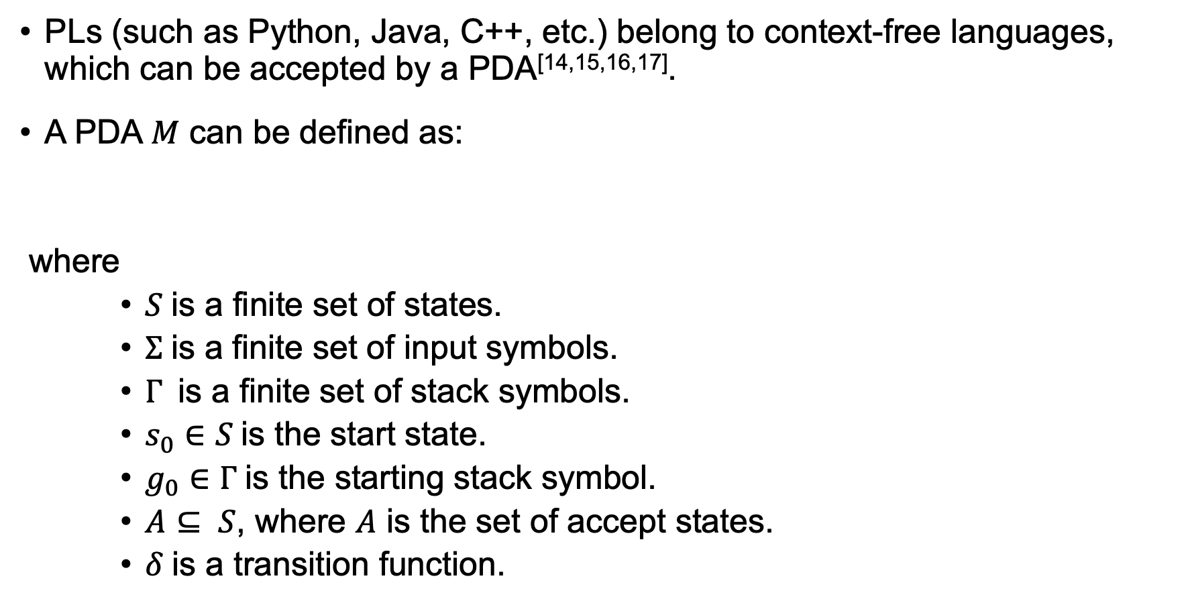
Methodology - PDA
PLs (such as Python, Java, C++, etc.) belong to context-free languages, which can be accepted by a PDA^{[14,15,16,17]}.
A PDA $M$ can be defined as:
where
$S$is a finite set of states.
$Σ$is a finite set of input symbols.
$Γ$is a finite set of stack symbols.
$s_{0}∈S$is the start state.
$g_{0}∈Γ$is the starting stack symbol.
$A⊆ S$, where $A$ is the set of accept states.
$δ$is a transition function.

Slide 19
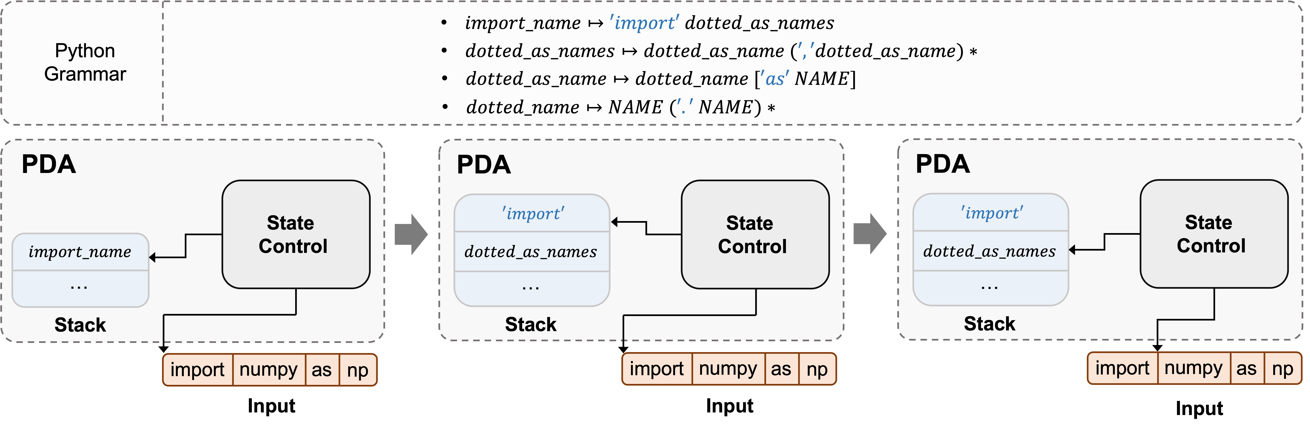
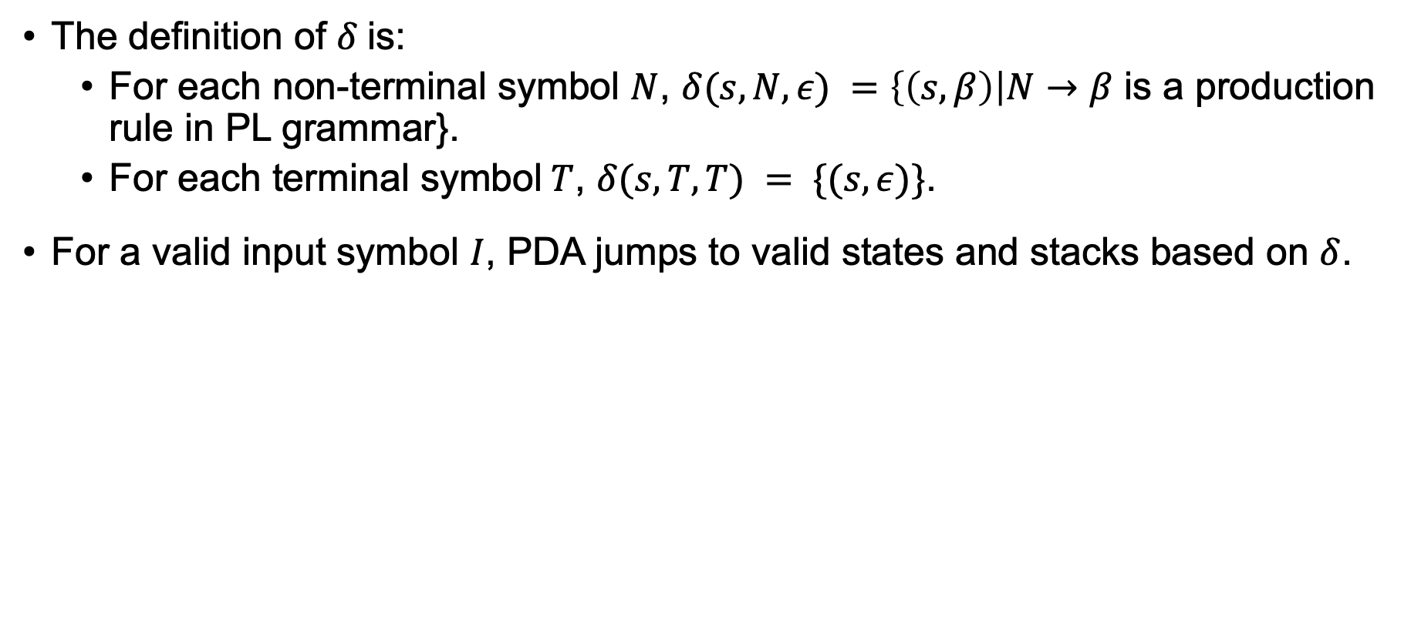
Methodology - PDA
The definition of $δ$is:
For each non-terminal symbol $N$, $δ(s,N,ε) =$ $\left\{\left(s, β\right)\right|N→β$ is a production rule in PL grammar}.
For each terminal symbol$T$, $δ(s, T, T) = \{(s, ε)\}$.
For a valid input symbol $I$, PDA jumps to valid states and stacks based on $δ$.

Slide 20
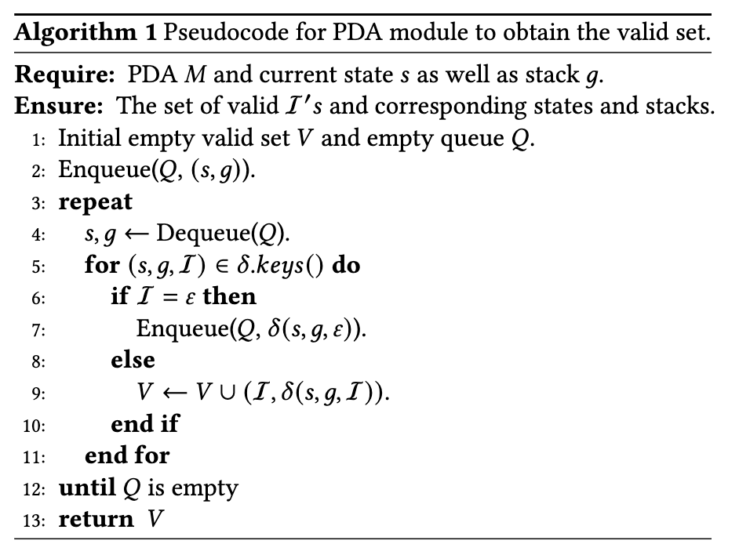
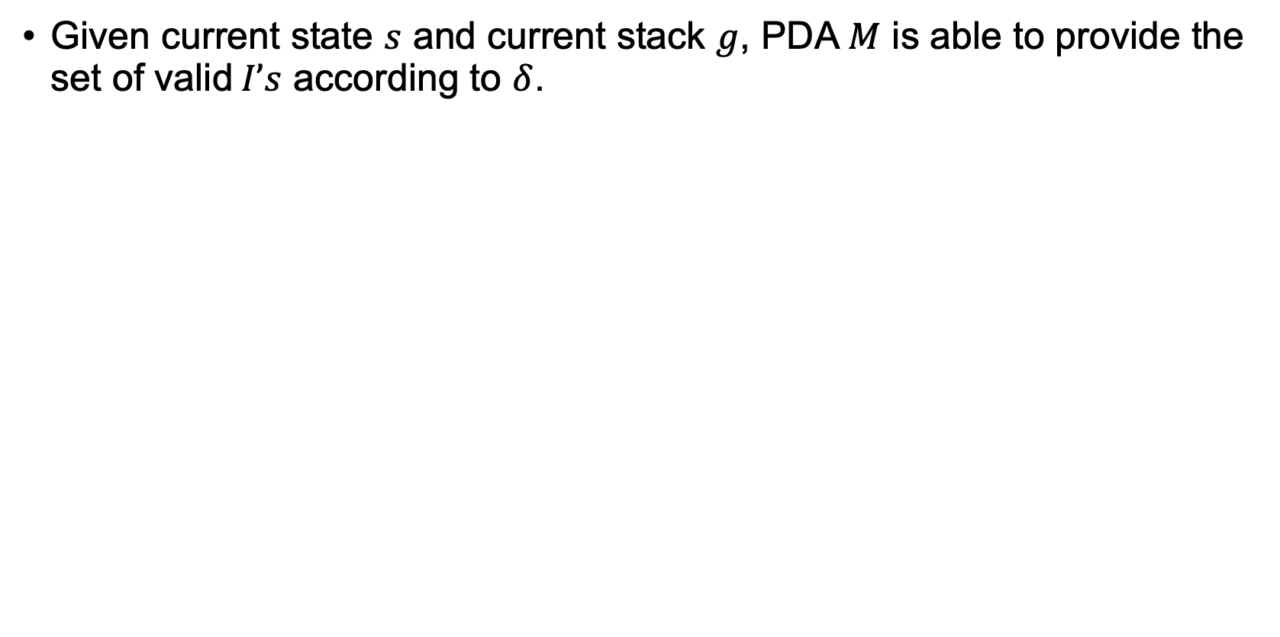
Methodology - PDA
Given current state $s$ and current stack $g$, PDA $M$ is able to provide the set of valid$I’s$ according to $δ$.

Slide 21
PART 05
CODEP

Slide 22
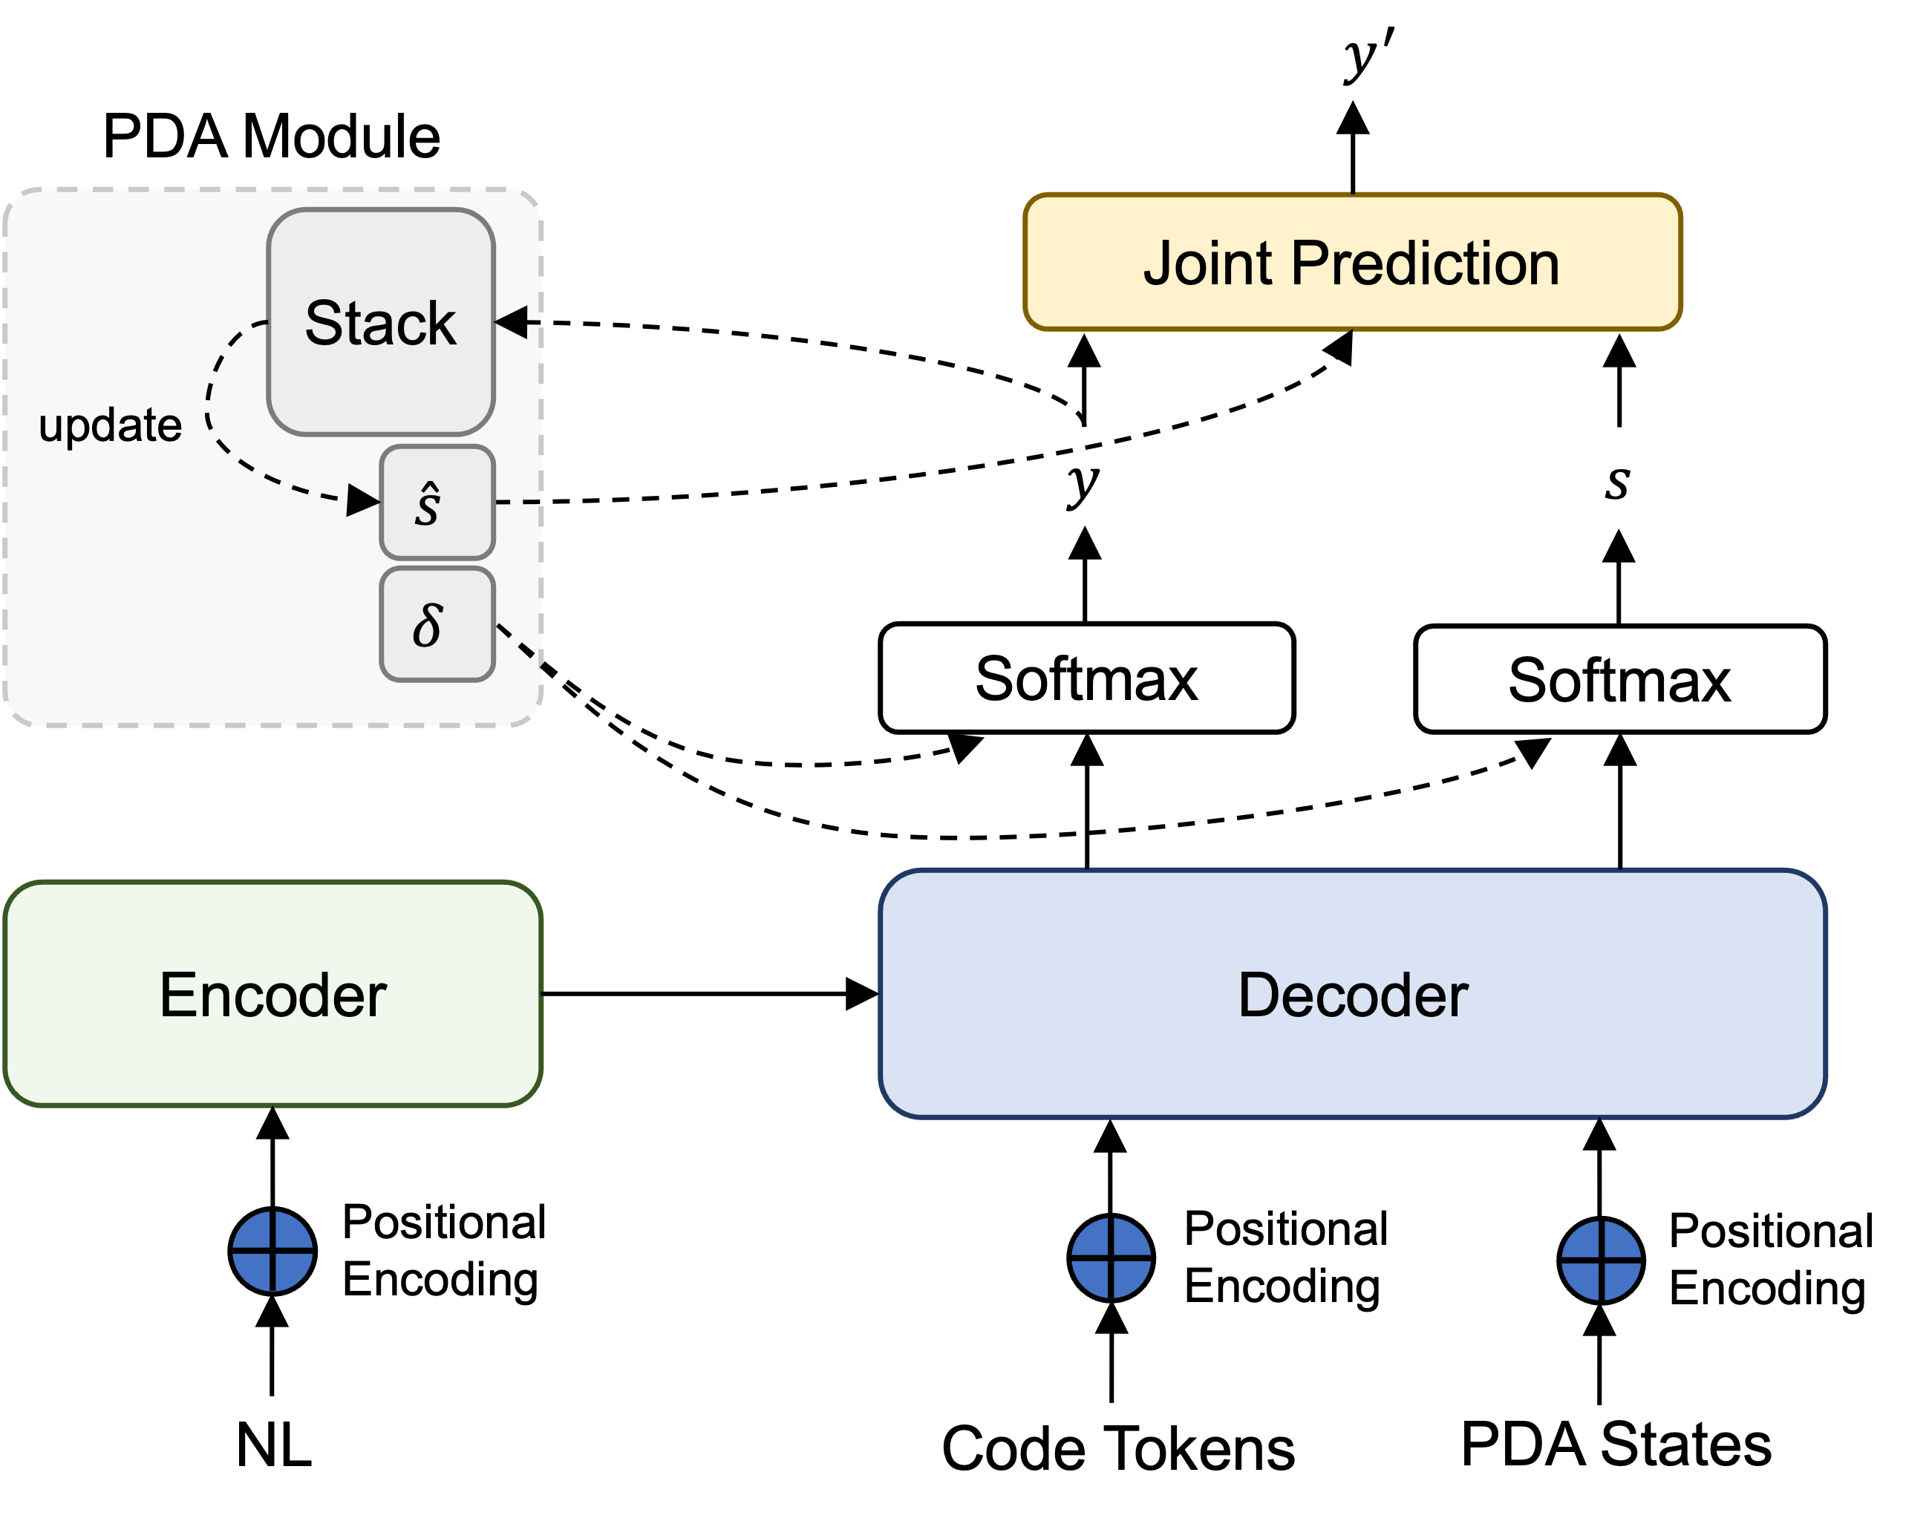
CODEP
This framework can be compatible with existing Seq2Seq models, no matter it is an encoder-decoder or a decoder only.
We mainly modify the decoder side of models to help models generate grammatical code by adding
PDA module (Methodology),
State representation,
State prediction task,
Joint prediction with state.

Slide 23
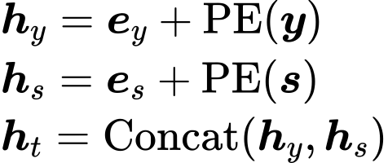
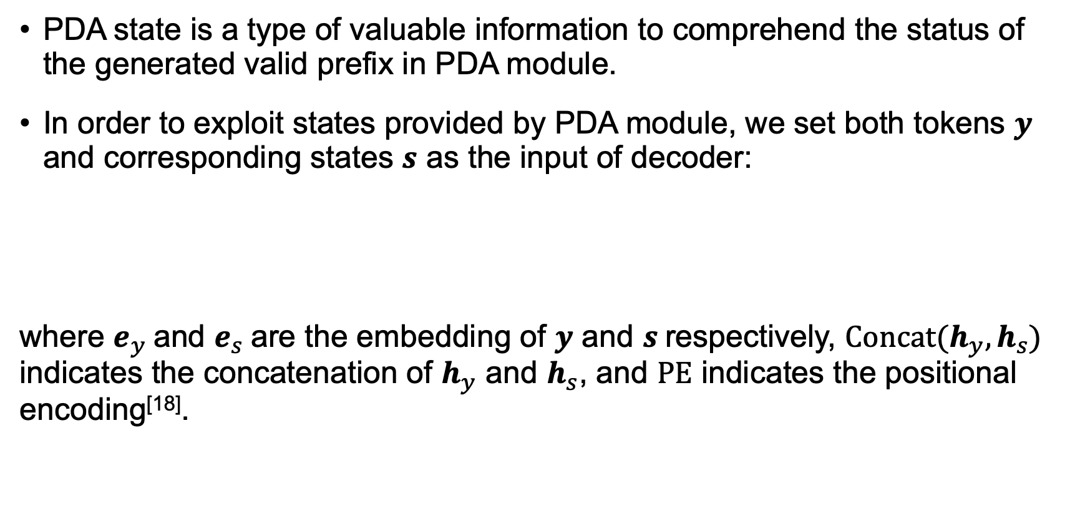
CODEP – Token & State Representation
PDA state is a type of valuable information to comprehend the status of the generated valid prefix in PDA module.
In order to exploit states provided by PDA module, we set both tokens $y$ and corresponding states $s$ as the input of decoder:
where $e_{y}$and $e_{s}$are the embedding of $y$ and $s$respectively, $Concat(h_{y},h_{s})$ indicates the concatenation of $h_{y}$ and $h_{s}$, and $PE$ indicates the positional encoding^{[18]}.

Slide 24
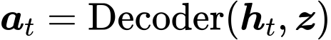
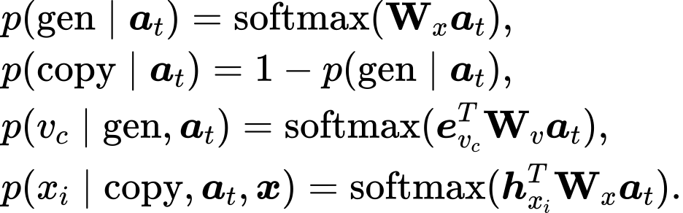
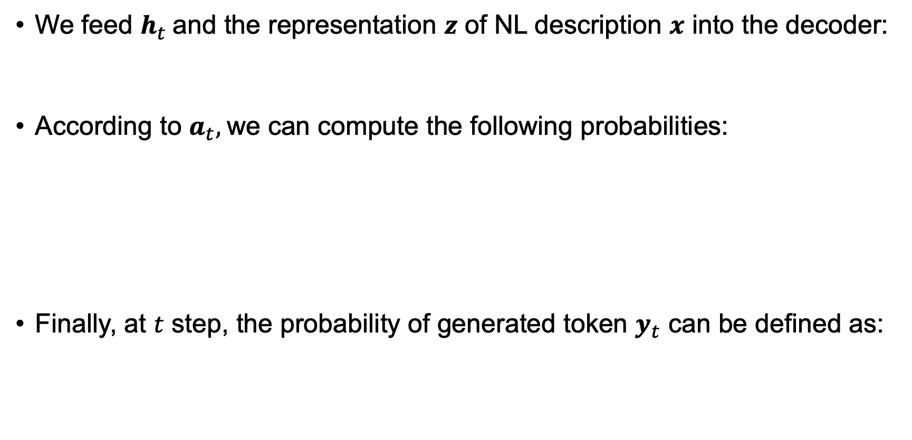
CODEP – Token Prediction Task
We feed $h_{t}$and the representation $z$ of NL description $x$ into the decoder:
According to $a_{t},$we can compute the following probabilities:
Finally, at $t$ step, the probability of generated token $y_{t}$ can be defined as:

Slide 25
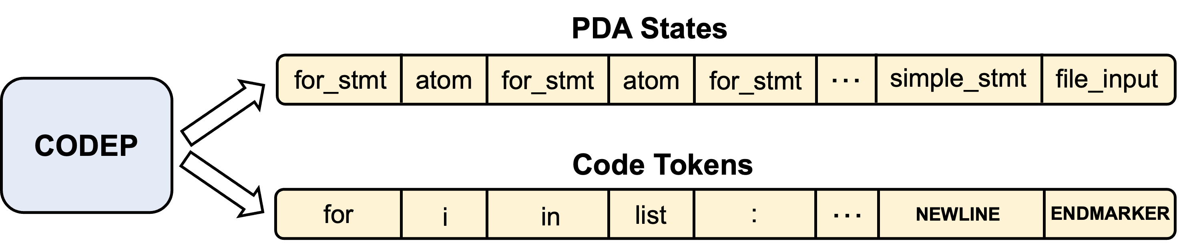
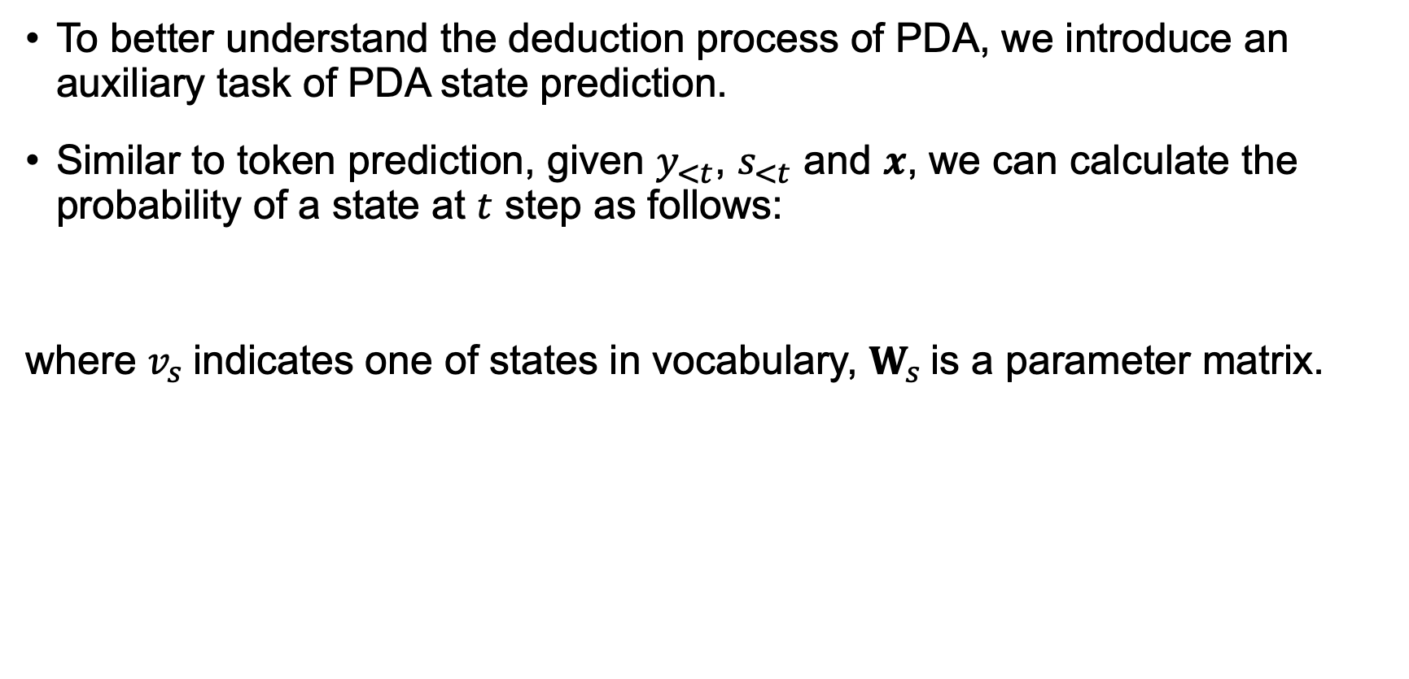
CODEP – State Prediction Task
To better understand the deduction process of PDA, we introduce an auxiliary task of PDA state prediction.
Similar to token prediction, given $y_{<t}$, $s_{<t}$ and $x$, we can calculate the probability of a state at $t$ step as follows:
where $v_{s}$indicates one of states in vocabulary, $W_{s}$is a parameter matrix.

Slide 26
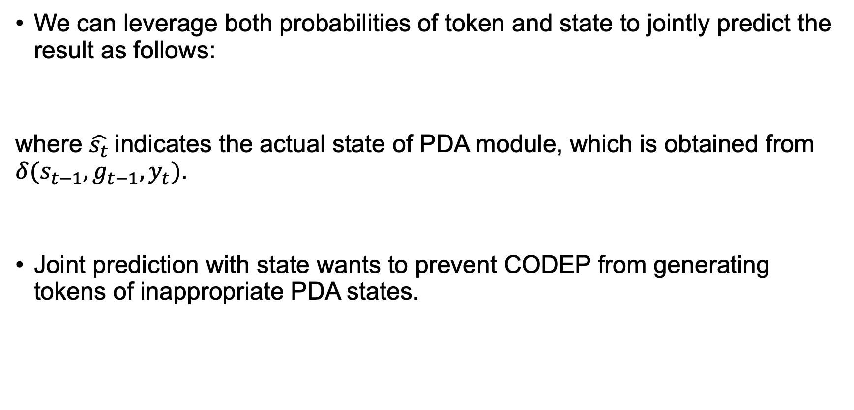
CODEP – Joint Prediction with State
We can leverage both probabilities of token and state to jointly predict the result as follows:
where $\hat{s_{t}}$indicates the actual state of PDA module, which is obtained from $δ(s_{t−1}, g_{t−1}, y_{t})$.
Joint prediction with state wants to prevent CODEP from generating tokens of inappropriate PDA states.

Slide 27
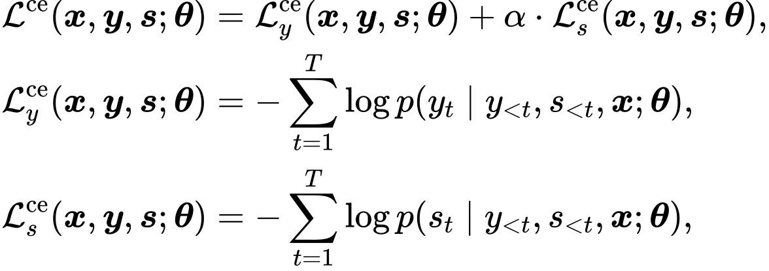
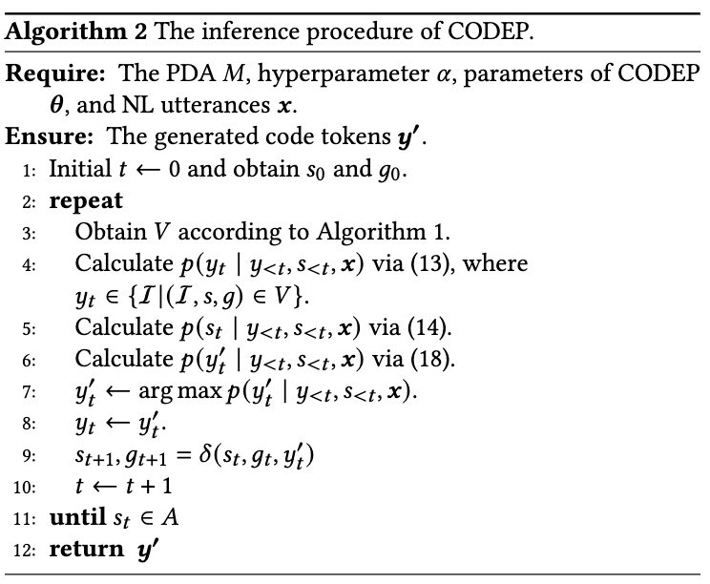
CODEP – Training and Inference
The purpose of the training stage is to minimize the sum of cross-entropy loss for two tasks:
In the inference stage, we have

Slide 28
PART 06
Experiments

Slide 29
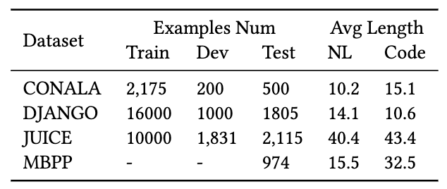
Experiments – Setup
PDA
The popular PL Python (both Python2 and Python3).
Dataset
Base Model
We select two typical Seq2Seq models, i.e., LSTM and Transformer.

Slide 30
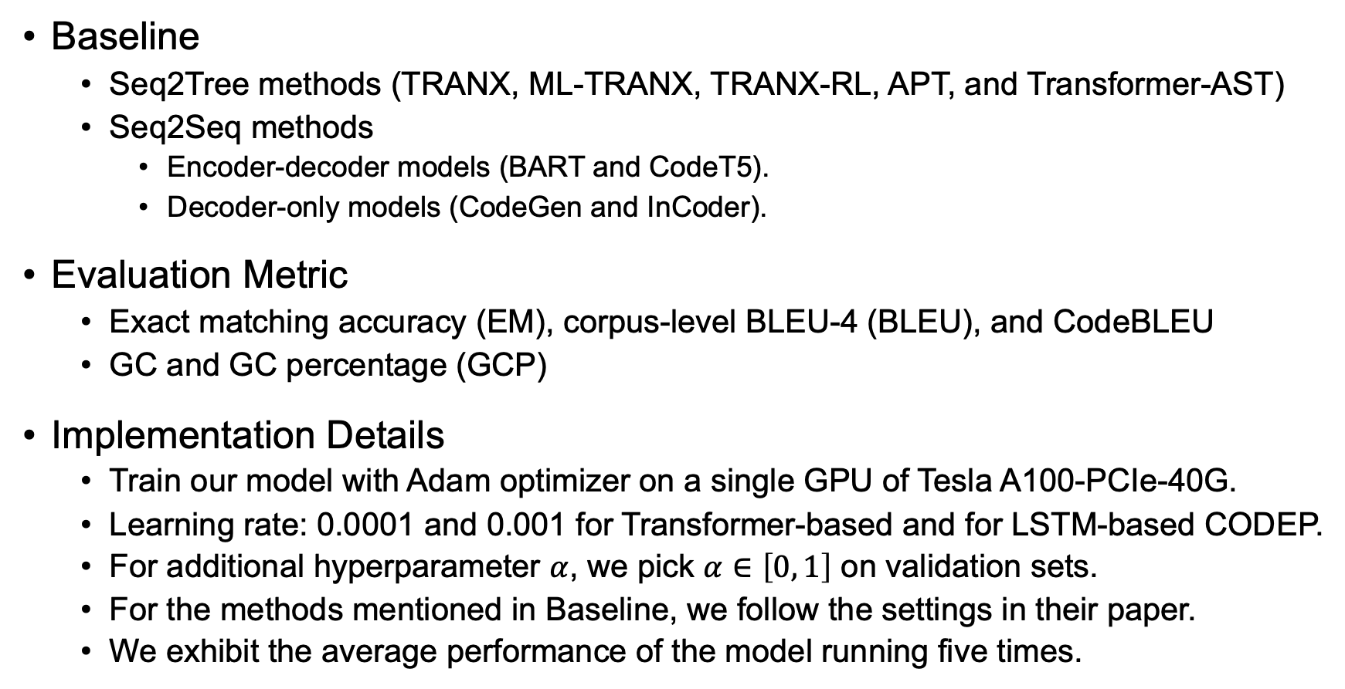
Experiments – Setup
Baseline
Seq2Tree methods (TRANX, ML-TRANX, TRANX-RL, APT, and Transformer-AST)
Seq2Seq methods
Encoder-decoder models (BART and CodeT5).
Decoder-only models (CodeGen and InCoder).
Evaluation Metric
Exact matching accuracy (EM), corpus-level BLEU-4 (BLEU), and CodeBLEU
GC and GC percentage (GCP)
Implementation Details
Train our model with Adam optimizer on a single GPU of Tesla A100-PCIe-40G.
Learning rate: 0.0001 and 0.001 for Transformer-based and for LSTM-based CODEP.
For additional hyperparameter $α$, we pick $α∈\left[0, 1\right]$ on validation sets.
For the methods mentioned in Baseline, we follow the settings in their paper.
We exhibit the average performance of the model running five times.

Slide 31
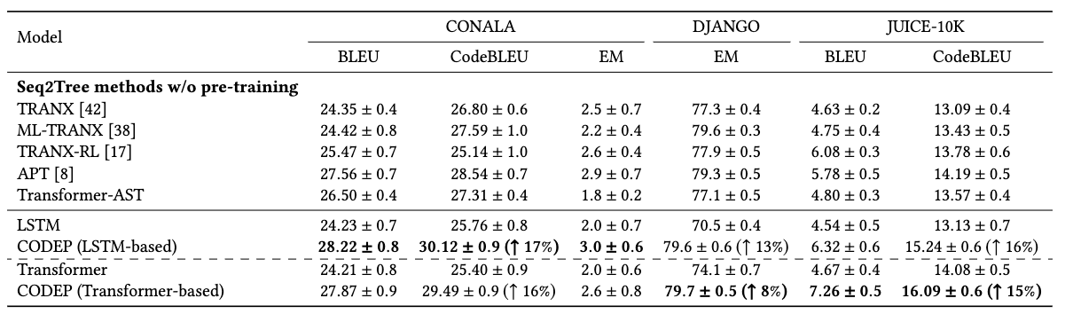
Experiments – CODEP vs Seq2Tree methods
CODEP substantially outperforms SOTA Seq2Tree methods without pre-training on three public benchmark.

Slide 32
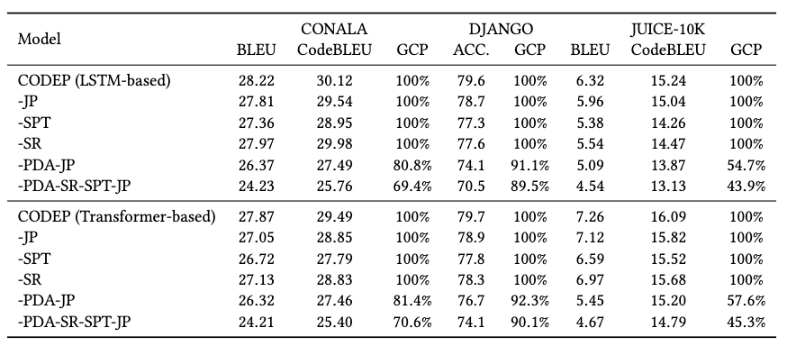
Experiments – Ablation Study
Each part of CODEP contributes and PDA module is the most critical part of CODEP.

Slide 33
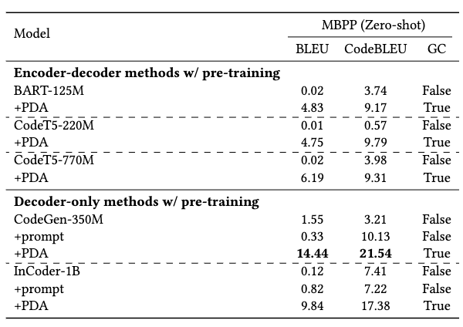
Experiments – Improvement with the PDA module
Under the constraints of PDA module, pre-training models are guided to exert their capabilities by generating grammatical codes.

Slide 34
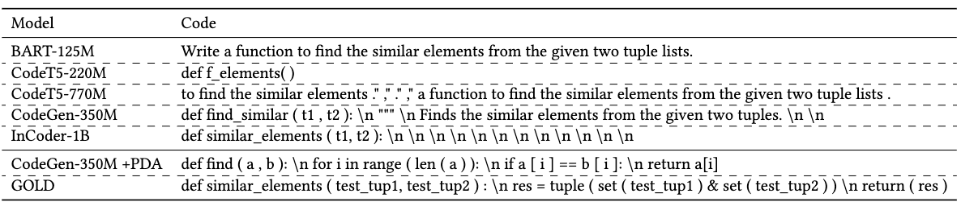
Experiments – Case Study
Although the code generated by CodeGen-350M + PDA still falls short of GOLD, we still think it is an impressive result considering that it is under the zero-shot setting.

Slide 35
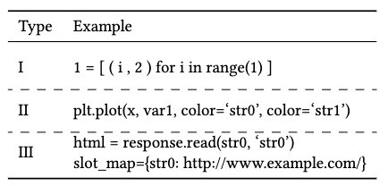
Experiments – Compilation Error Analysis
The compilation rate of CODEP on CONALA dataset is 99.2%.
For the first two types of errors, we are able to modify the transfer function, while the last type of error can be avoided using engineering methods.

Slide 36
PART 07
Limitation

Slide 37
Limitation
First, a specific PDA should be built for each PL, and we only built PDA for Python (including both Python2 and Python3). However, PDA can recognize context-free language to which PL belongs, due to time and memory limitations of running PL^{[17]}. In future work, we will build PDAs for more PLs.
Second, our work ensures GC, but neither our method nor other methods can prevent compilation errors. With our proposed training framework, our method outperforms other methods on compilation rates, e.g., CODEP has 99.2% compilation rates after training on CONALA.
Third, using PDA will increase CPU operation and memory overhead, but it is still acceptable.

Slide 38
PART 08
Conclusion & Future work

Slide 39
Conclusion
In this paper, we have proposed a Seq2Seq-based framework CODEP.
First integrate the deduction of PDA into deep learning for code generation.
CODEP adds PDA module, state representation, state prediction task, and joint prediction for the decoder of CODEP.
PDA module guarantees the GC of generated codes
The others make use of valid information provided by PDA module (i.e., PDA state) to generate codes better.
Extensive experimental results and analyses verify the effectiveness and generality of CODEP.
CODEP dramatically enhances the performance of base models and outperforms SOTA Seq2Tree methods without pre-training.
The ablation study demonstrates each component of CODEP contributes.
With the help of PDA module, pre-trained models also achieve significant improvements.

Slide 40
Future work
PDA module shows excellent potential in code generation tasks under zero-shot setting.
Can help pre-trained models apply to niche PLs that have little data.
PDA can accommodate context-free language to satisfy grammar constraints, not just PL.
We hope this work sheds light on future work in this direction.

Slide 41
Thanks
Q & A
CODEP: Grammatical Seq2Seq Model for General-Purpose Code Generation
Notes:
Thanks

Slide 42
Reference
[1] Wang Ling, Phil Blunsom, Edward Grefenstette, Karl Moritz Hermann, Tomás Kociský, Fumin Wang, and Andrew W. Senior. 2016. Latent Predictor Networks for Code Generation. In ACL (1). 599–609.
[2] Yue Wang, Weishi Wang, Shafiq R. Joty, and teven C. H. Hoi. 2021. CodeT5: Identifier-aware Unified Pre-trained Encoder-Decoder Models for Code Understanding and Generation. In EMNLP (1). 8696–8708.
[3] Daya Guo, Shuai Lu, Nan Duan, Yanlin Wang, Ming Zhou, and Jian Yin. 2022. UniXcoder: Unified Cross-Modal Pre-training for Code Representation. In ACL(1). 7212–7225.
[4] Erik Nijkamp, Bo Pang, Hiroaki Hayashi, Lifu Tu, Huan Wang, Yingbo Zhou, Silvio Savarese, and Caiming Xiong. 2022. A Conversational Paradigm for Program Synthesis. CoRR abs/2203.13474 (2022).
[5] Daniel Fried, Armen Aghajanyan, Jessy Lin, Sida Wang, Eric Wallace, Freda Shi, Ruiqi Zhong, Wen-tau Yih, Luke Zettlemoyer, and Mike Lewis. 2022. InCoder: A Generative Model for Code Infilling and Synthesis. CoRR abs/2204.05999 (2022).
[6] Li Dong and Mirella Lapata. 2016. Language to Logical Form with Neural Attention. In ACL (1).
[7] Pengcheng Yin and Graham Neubig. 2018. TRANX: A Transition-based Neural Abstract Syntax Parser for Semantic Parsing and Code Generation. In EMNLP (Demonstration). 7–12.
[8] Binbin Xie, Jinsong Su, Yubin Ge, Xiang Li, Jianwei Cui, Junfeng Yao, and Bin Wang. 2021. Improving Tree-Structured Decoder Training for Code Generation via Mutual Learning. In AAAI. 14121–14128.
[9] Hui Jiang, Chulun Zhou, Fandong Meng, Biao Zhang, Jie Zhou, Degen Huang, Qingqiang Wu, and Jinsong Su. 2021. Exploring Dynamic Selection of Branch Expansion Orders for Code Generation. In ACL/IJCNLP. 5076–5085.

Slide 43
Reference
[10] Yihong Dong, Ge Li, and Zhi Jin. 2022. Antecedent Predictions Are Dominant for Tree-Based Code Generation. CoRR abs/2208.09998 (2022).
[11] Sijie Shen, Xiang Zhu, Yihong Dong, Qizhi Guo, Yankun Zhen, and Ge Li. 2022. Incorporating domain knowledge through task augmentation for front-end JavaScript code generation. In ESEC/SIGSOFT FSE. ACM, 1533–1543.
[12] Torsten Scholak, Nathan Schucher, and Dzmitry Bahdanau. 2021. PICARD: Parsing Incrementally for Constrained Auto-Regressive Decoding from Language Models. In EMNLP (1). Association for Computational Linguistics, 9895–9901.
[13] Gabriel Poesia, Oleksandr Polozov, Vu Le, Ashish Tiwari, Gustavo Soares, Christopher Meek, and Sumit Gulwani. 2022. Synchromesh: Reliable code generation from pre-trained language models. CoRR abs/2201.11227 (2022).
[14] Noam Chomsky. 1962. Context-free grammars and pushdown storage. MIT Res. Lab. Electron. Quart. Prog. Report. 65 (1962), 187–194.
[15] R James Evey. 1963. Application of pushdown-store machines. In Proceedings of the November 12-14, 1963, fall joint computer conference. 215–227.
[16] Marcel Paul Schützenberger. 1963. On context-free languages and push-down automata. Information and control 6, 3 (1963), 246–264.
[17] Arto Salomaa, Derick Wood, and Sheng Yu. 2001. A half-century of automata theory: celebration and inspiration. World scientific.
[18] Jonas Gehring, Michael Auli, David Grangier, Denis Yarats, and Yann N. Dauphin. 2017. Convolutional Sequence to Sequence Learning. In ICML (Proceedings of Machine Learning Research, Vol. 70). PMLR, 1243–1252.

